Slide 1
Introduction: Understanding the Project Dataset
Ecommerce CRM Data
RFM Analysis
Company Name is assumed as Xpreskart.com
Key Insights:
1.The dataset encompasses transactions from 01/12/2010 to 09/12/2011 for a non-store online business based and registered in the UK. Specializing in distinctive all-occasion gifts, the company's clientele includes a significant number of wholesale customers.
2.The xpreskart company sells products in 38 countries including its home country United Kingdom.
3.The Data contains 541,909 rows and 8 columns.
4.There are 3922 unique items.
NOTE: As DATA is at Invoice level, hence for multiple items of same Invoice NO having multiple rows has been generated for same customerID.
“Let's dive deep into the dataset to extract meaningful insights”

Slide 2
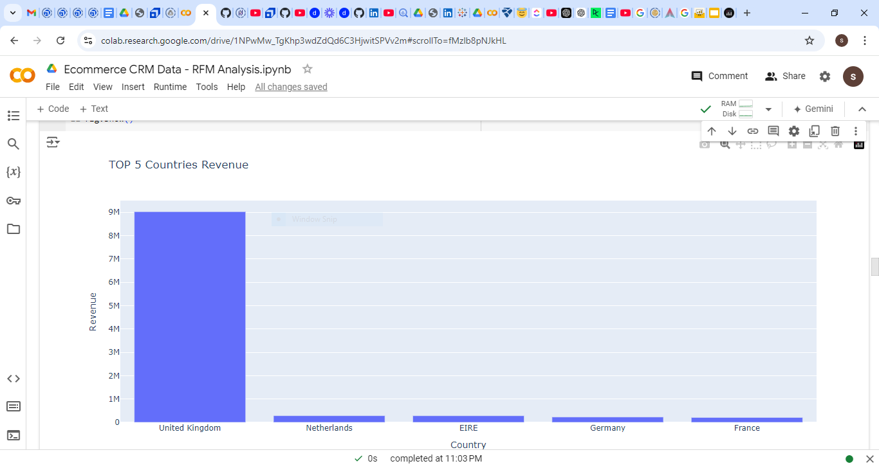
TOP 5 Products
Stock Code Description Quantity
23843 PAPER CRAFT , LITTLE BIRDIE 80995
23166 MEDIUM CERAMIC TOP STORAGE JAR 78033
84077 WORLD WAR 2 GLIDERS ASSTD DESIGNS 55047
85099B JUMBO BAG RED RETROSPOT 48474
85123A WHITE HANGING HEART T-LIGHT HOLDER 37599
TOP 5 Countries Revenue
COUNTRY REVENUE
United Kingdom 9025222.084
Netherlands 285446.340
EIRE 283453.960
Germany 228867.140
France 209715.110
TOP 5 Competitors
1.Amazon.co.uk
2.ebay.co.uk
3.etsy.co.uk
4.next.co.uk
5.Tesco.co.uk

Slide 3
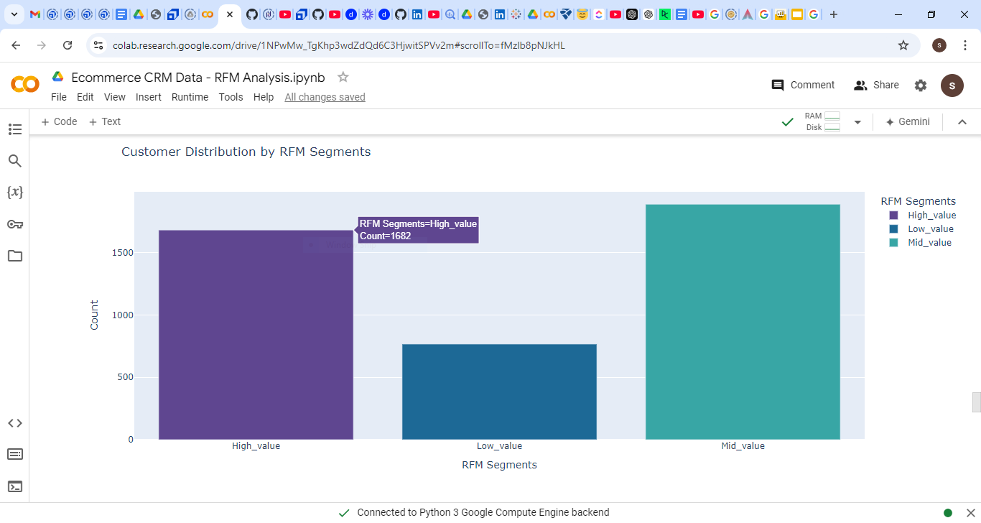
RFM_Score:
High_value >9
Mid_value <9
Low_value <5
NOTE RFM Scale: R=4,F=4,M=4 == 12
RFM_Segments Bins:
High_value count of customers = 1682
Mid_value count of customers = 1889
Low_value count of customers = 767

Slide 4
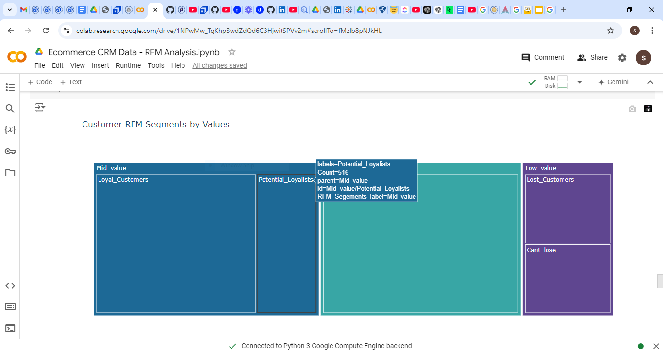
Key Insights:
1. VIP_customers are 1682 with RFM segment belongs to High_value.
2. loyal customers are 1373 with RFm segments Mid_value
3. Potential Loyalist count of customers is 516,belongs to Mid_value segment
4. cant_lose customers are 382 with RFm segments LOW_value
5.lost_customers are 385 with RFm segments belonging to Low_value

Slide 5
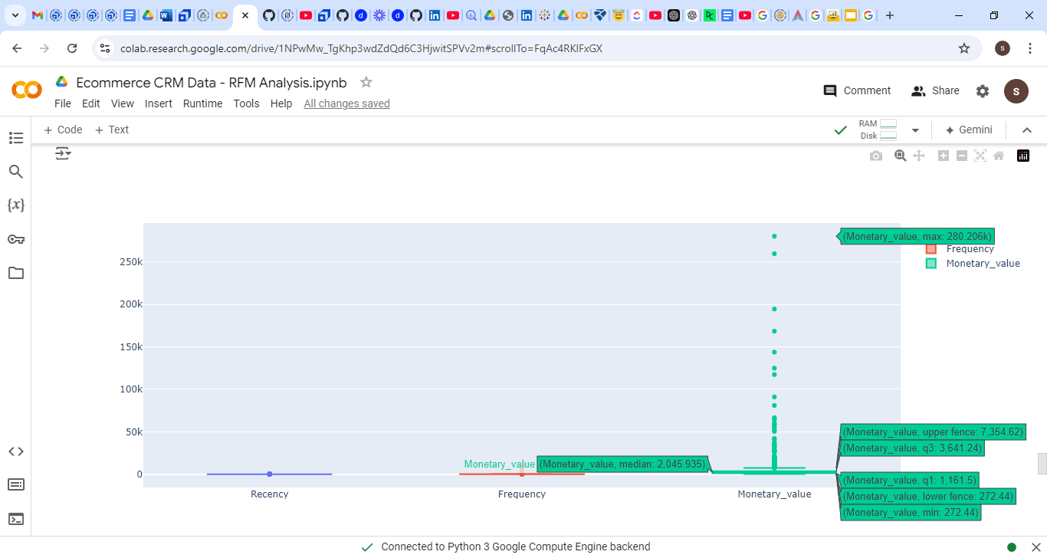
The Box plot deep dive into only VIP_customers belonging to High_Value RFM customer segment.
Key Insights:
1. Monetary_value with $259k and $280.206k which is a Outlier.
Upper fence value is 7,354
Lower fence value is 272

Slide 6
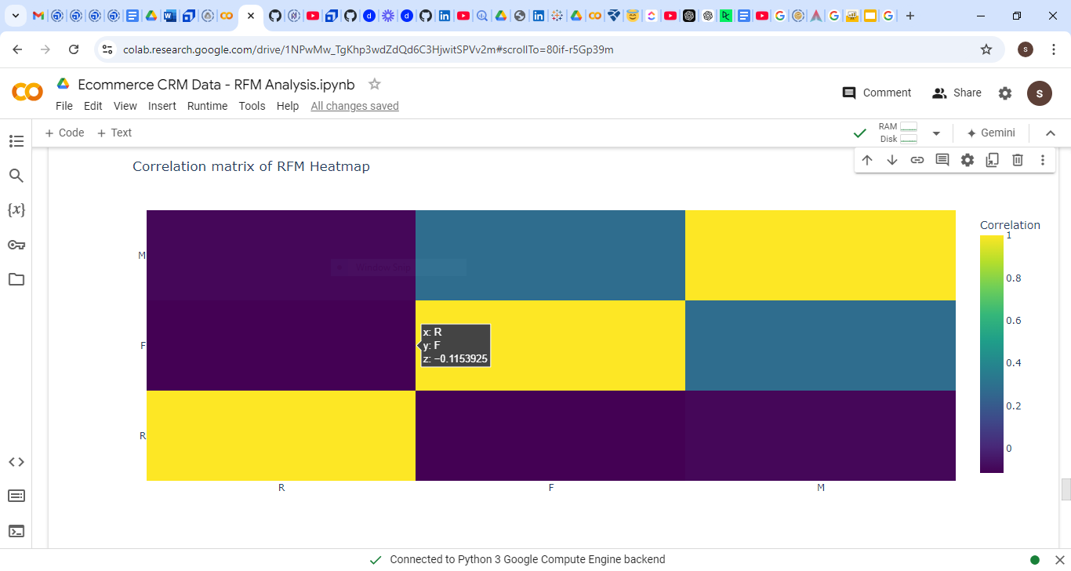
Key Insights:
NO correlation between variables
In other words: Negative correlation observed between ;
Frequency & Recency (z= -0.1153) . AND
Monetary & Recency (z= -0.0968).

Slide 7
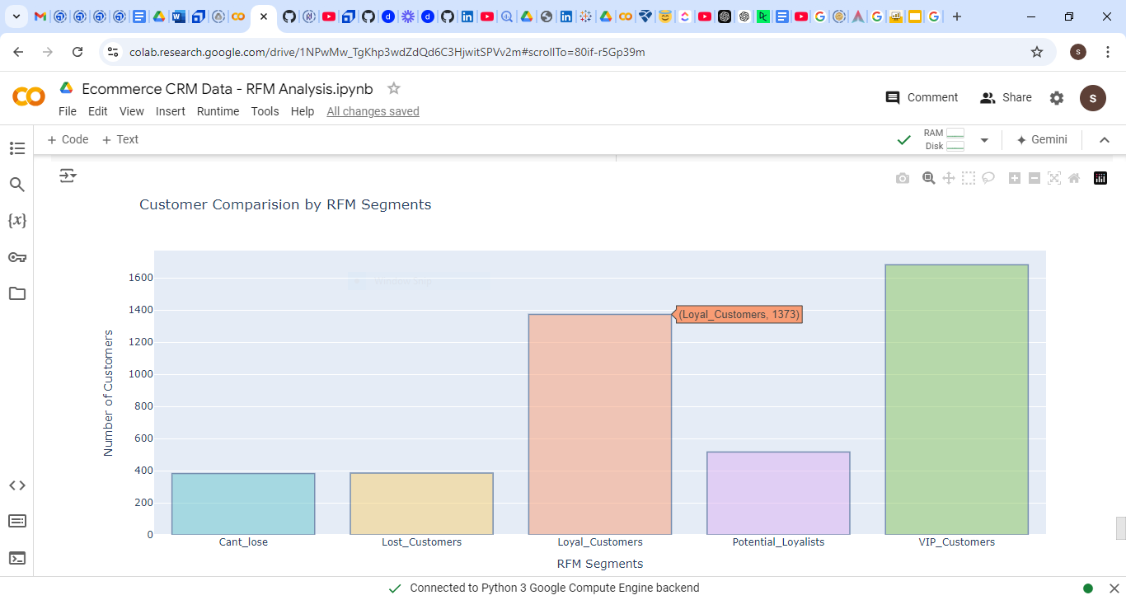
Customer Comparison by RFM Segments based on RFM Score.
1. VIP_customers are 1682
2. Loyal customers are 1373
3. Potential Loyalist are 516,
4. Cant_lose customers are 382
5.Lost_customers are 385

Slide 8
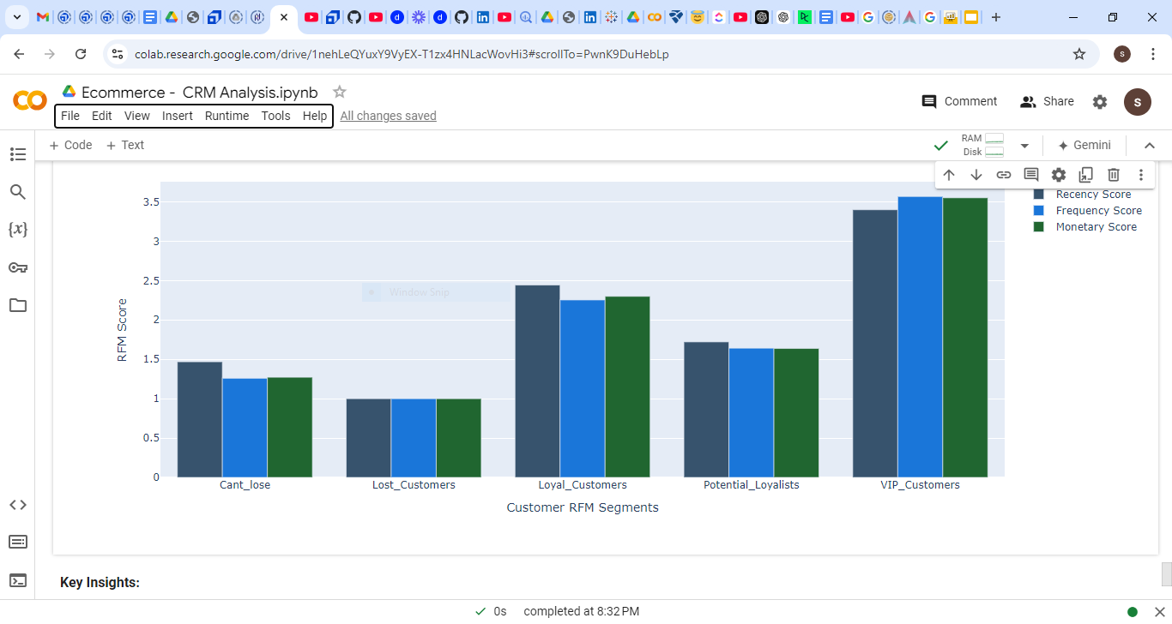
1.VIP_customers: Mean value, Recency Score is 3.39,Frequency is 3.56 & Monetary_Value 3.55
2.Loyal_Customers:Mean values of Recency Score is 2.44,Frequency is 2.25 & Monetary_Value 2.29
3.Potential_Loyalist: Mean values of Recency Score is 1.72,Frequency is 1.64 & Monetary_Value 1.73
4.Cant_Lose:Mean values of Recency Score is 1.46,Frequency is 1.25 & Monetary_Value 1.27

Slide 9
Conclusion and Next Steps
1.Reduce the churn of customers
2.Customer segmentation can help tailor marketing efforts for increased engagement.
3.Insights gathered can guide product development and customer service enhancements.
4.Understanding customer trends fuels growth and improves satisfaction
5.ROI on marketing of RFM customer segments can be ascertained.
6.RFM analysis facilitates Increase revenue & Profits.
Recommendations:
Further data analysis of all RFM_Customer_Segement of Xpreskart company is recommended.
Thank you for your kind attention, and let's embrace Data analytics for Business success!

